Slide 1

Walmart Sales Prediction
Lachandra Ash
11/13/2022

Slide 2

Approach
Walmart needs to increase their profit through their product sales to each consumer.
Walmart wants to increase their sales during the Super bowl event, Labor day, Thanksgiving, and Christmas.

Slide 3
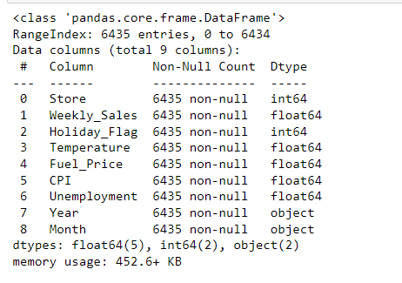

Walmart Dataset

Slide 4
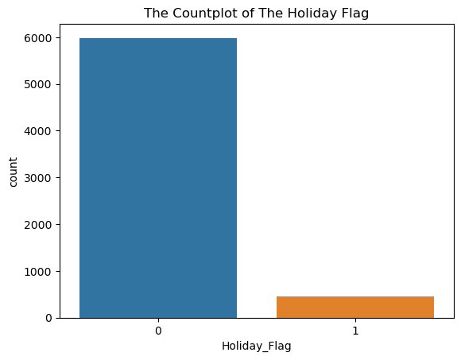
Holiday Flag Countplot
There are more non-holiday weeks versus holiday week.

Slide 5
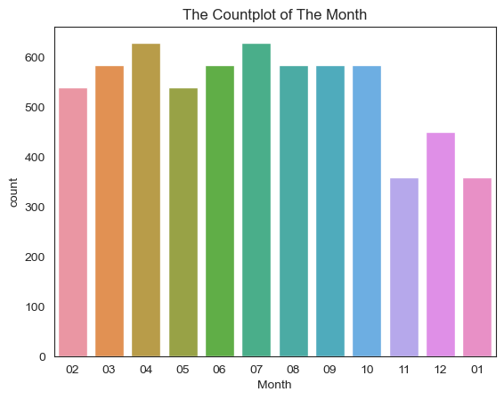
Month Countplot
Month 04 and Month 07 had the highest number of sales.
Months 02, 03, 05, 06, 08, 09, and 10 had the second highest number of sales and the months sales were near the same number of sales.
Months 11, 12, and 01 sold the least number of sales.

Slide 6
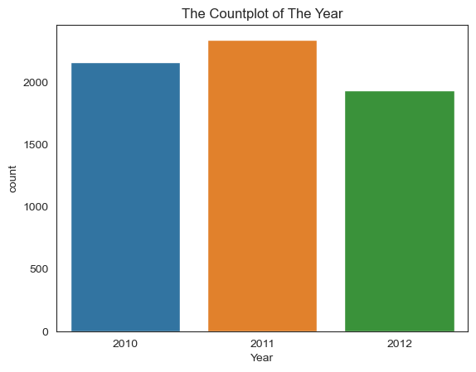
Year Countplot
Year 2011 has the highest number of sales, Year 2010 has the second highest number of sales, and Year 2012 has the least number of sales.

Slide 7
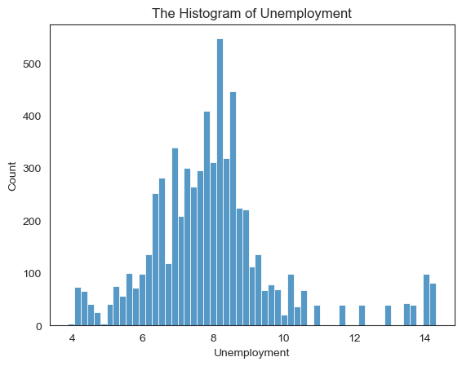
Unemployment Histogram
The employment rate of 8 had the highest number of employment rates.
The least number of employment rates are between 1-6 and 9-10.

Slide 8
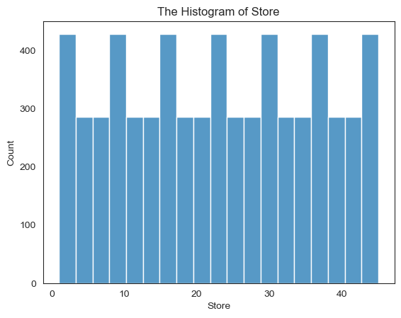
Store Histogram
There are forty-five stores within the dataframe.

Slide 9
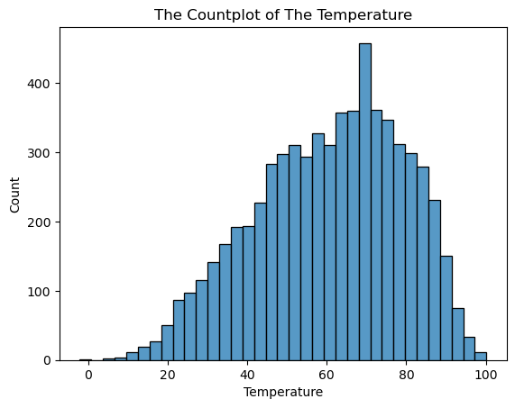
Temperature Histogram
The seventy-degree temperature had the highest number of days with sales.
As the temperature raised from 0 to 70 degrees, the number of sales began to increase.
The warmer the temperature after 70 degrees, the sales began to drop

Slide 10
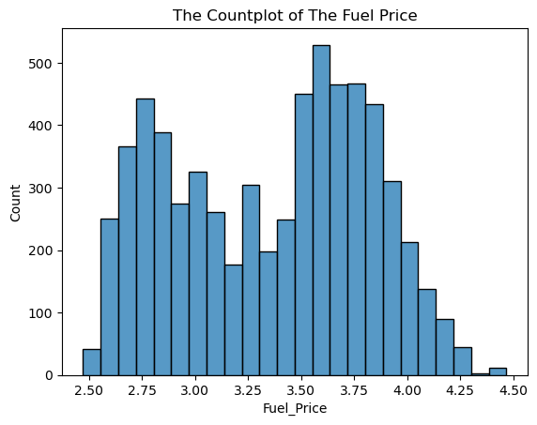
Fuel Price Histogram
The fuel prices with the highest count of consumers are approximately between $3.50 and $3.75.
The more expensive the fuel prices became, the number of consumers who brought the fuel began to decrease.
The fuel prices with the second highest count of consumers are approximately between $2.60-$3.10.

Slide 11
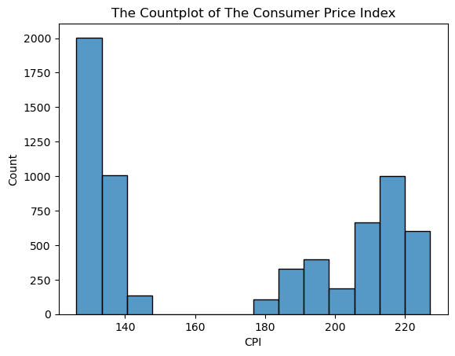
Consumer Price Index Histogram
The consumer price index has the highest number of consumers at the lowest number of the index.
The consumer price index has the least number of consumers between 140 through approximately 205.

Slide 12
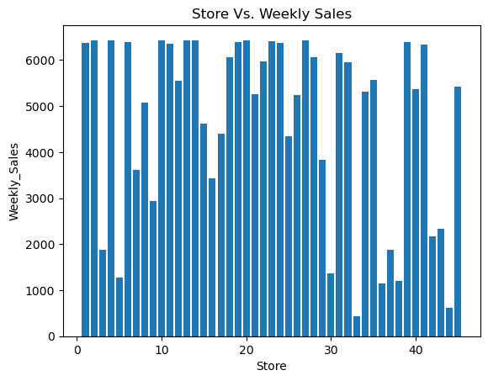
Store and Weekly Sales Barplot
Stores 1,2,4,6,10,11,13,14,18,19,20,21, 23, 24, 25, 28, 29, 32, 33, 40, and 45 had the highest number of weekly sales.

Slide 13
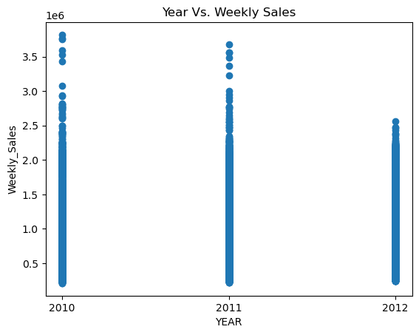
Year Vs. Weekly Sales Scatterplot
Year 2010 had the highest number of sales and year 2012 had the least number of sales.
Year 2011 had the second highest number of sales.

Slide 14
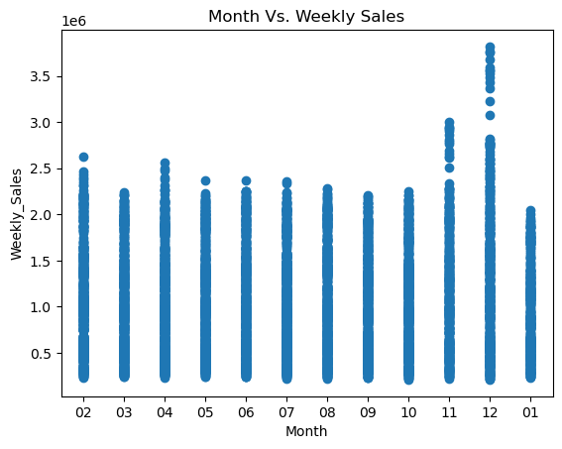
Month Vs. Weekly Sales
Months 12 and 11 had the highest number of weekly sales.
Months 03 and 01 had the least number of weekly sales.
Month 02, 04. and 05-10 had approximately same number of weekly sales.

Slide 15
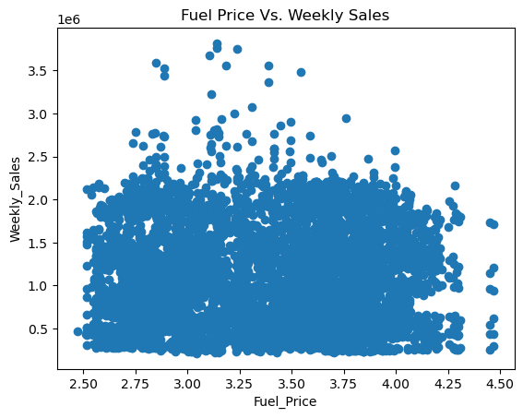
Fuel Price Vs. Weekly
Fuel Prices that are approximately between the ranges of $2.75- $4.00 have near the same number of weekly sales.

Slide 16
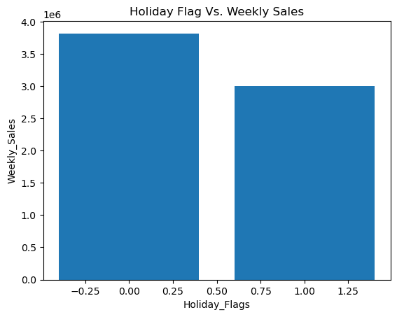
Holiday Flag Vs.Weekly Sales Barplot
The holiday weeks have the least number of weekly sales versus the non-holiday weeks.

Slide 17
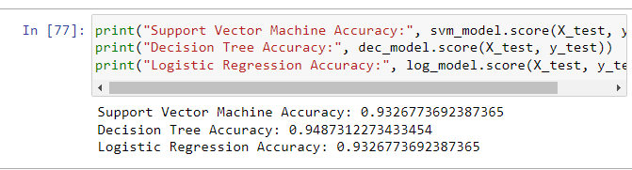
The Models
The three models that were used for the accuracy score are DecisionTreeClassifier, Logistic Regression, and Support Vector Machine Accuracy.
The holiday flag column was dropped before fitting the model. The data was trained, tested, and split.
Each model was trained, and the Decision Tree accuracy score was 94.8%, Logistic Regression accuracy score was 93.3%, and the Support Vector Machine accuracy score was 93.3%.

Slide 18

Conclusion
There was more non-holiday versus the holiday weeks.
The non-holiday weeks had more weekly sales versus the holiday weeks.
. More consumers purchase items from Walmart during the spring and summer months.
The least number of consumer purchases took place during the Thanksgiving and Christmas holidays.
Walmart can increase their number of weekly sales during the holiday weeks by running ads and discounting products.
Since there are less holiday weeks, the Walmart stores will always experience the least number of weekly sales versus the non-weekly sales. The three models produced near the same accuracy score.

